Slide 1

CSS : Cascading Style Sheet

Slide 2
General Guideline
© (2024) ABES Engineering College.
This document contains valuable confidential and proprietary information of ABESEC. Such confidential and proprietary information includes, amongst others, proprietary intellectual property which can be legally protected and commercialized. Such information is furnished herein for training purposes only. Except with the express prior written permission of ABESEC, this document and the information contained herein may not be published, disclosed, or used for any other purpose.

Slide 3

CSS CSS - Box Model, Selector, Combinators, Specificity, Flex-box/Grid, Display, Position, Media Query, Transition
Content
Day 1

Slide 4
CSS stands for Cascading Style Sheets. It is a stylesheet language that is used to describe the visual presentation of a web page written in HTML (Hypertext Markup Language). HTML creates the structure of the page, while CSS adds styling to that structure. CSS was created by Håkon Wium Lie to enhance the visual aspects of websites.
What is CSS?

Slide 5
The term "cascade" refers to the priority scheme determining which CSS rules are applied when multiple rules target an element. This scheme takes into account specificity and inheritance, ensuring that the most specific and latest rules are applied. Why use CSS? CSS is used to provide styling to HTML elements, making web pages visually appealing and user-friendly.
Why the word "cascade"?

Slide 6
The CSS Box model defines how elements are rendered and how their dimensions are calculated. It describes the structure of an element as a rectangular box that has content, padding, a border, and a margin.
CSS Box Model

Slide 7
1. Content The innermost component of the box model is the actual content of the element. It can be text, image, video, etc. The content area is defined by the width and height properties. 2. Padding The space between the actual content and the border of the element is the padding. The padding area is defined by the property padding. 3. Border The border surrounds the content and padding and gives the visual border of the element. The border properties can be controlled using the border keyword. 4. Margin The margin is the space outside the element that separates it from other elements in the layout. The margin of the element is controlled by the margin property.
The box model consists of four main components, which are

Slide 8
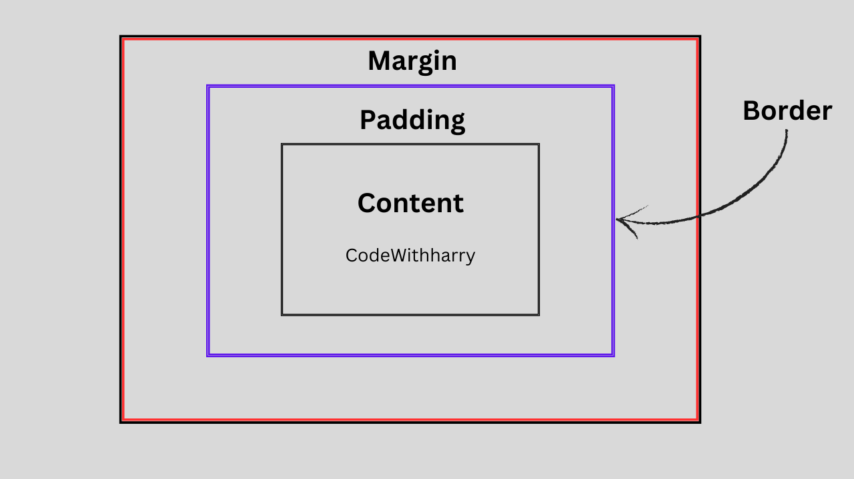
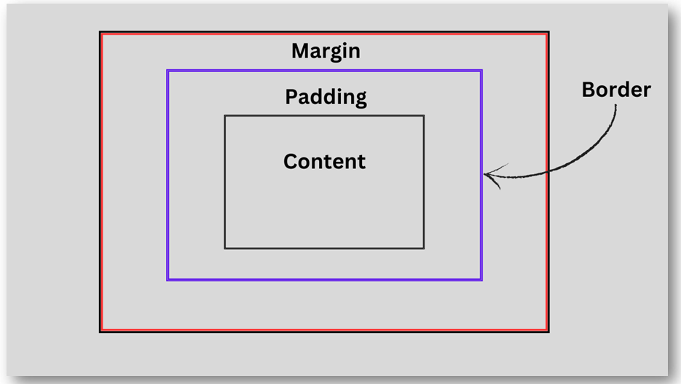
The CSS Box model can be visually represented as:

Slide 9
The total width and height of the element is calculated with the formula: Total Width = Width + Left Padding + Right Padding + Left Border + Right Border + Left Margin + Right Margin Total Height = Height + Top Padding + Bottom Padding + Top Border + Bottom Border + Top Margin + Bottom Margin <style> p{ width: 200px; height: 300px; padding: 15px; //Calculate the total height and width?? border: 10px solid red; margin: 5px; } </style>
Calculating the total dimension of the element

Slide 10
Total Width = 200px (width) + 15px (left padding) + 15px (right padding) + 10px (left border) + 10px (right border) + 5px (left margin) + 5px (right margin) = 260px. Total Height = 300px (Height) + 15px (Top Padding) + 15px (Bottom Padding) + 10px (Top Border) + 10px (Bottom Border) + 5px (Top Margin) + 5px (Bottom Margin) = 360px
Here, the total height and width will be represented as

Slide 11
CSS selectors allow us to choose specific elements and apply styles to them. Suppose we want to add a custom style to only a specific tag(s). There, We can make use of CSS selector. There are different types of CSS selectors, which are as follows: Universal Selector Element Selector Id Selector Class Selector Group Selector
CSS Selectors

Slide 12
Universal selector represented by "*" targets all the HTML elements on the page. The syntax of Universal Selector is as follows: * { property : value; } Example <style> * { color: purple; text-align: center; } </style>
Universal Selector

Slide 13
The element selector selects the target element based on the specific type. Suppose you want to underline all the <p> tags; in this case, the element selector will be the best choice. syntax of Element Selector is as follows p { property : value; } Example p{ text-decoration: underline; }
Element Selector (Type Selector)

Slide 14
The ID selector targets the elements based on the specific ID. It is written with the hash “#” character followed by the ID name in the style sheet. The syntax of ID Selector is as follows: #ID { property : value; } #title { text-align: center; color: red; }
ID Selector

Slide 15
The class selector does the same job as the id selector, a class selector helps group various types of elements. Suppose, we want to give a custom style to a specific group of elements. In this case, the class selector is the best option. The syntax of Class Selector is as follows: .class { property : value; } Example .red { color: red; }
Class Selector

Slide 16
The group selector is used to minimize the code. Commas "," are used to separate each selector in a grouping. This reduces the number of lines of code. The code also looks clean. The syntax of Group Selector is as follows: div, p, a { property : value; }
Group Selector

Slide 17
It explains the relation between multiple or single selector. There are four major combinators Descendant Selector It selects all the elements to present inside another specified HTML element. Eg: div p{ background-color: aqua; border: 10px solid red; margin: 5px; } <div> <p>ABES Engineering College</p> <p>ABES Engineering College</p> </div>
CSS Combinators

Slide 18
It selects only the first generation descendants of a specified element. Eg: div>p { color: wheat; background-color: green; }
Child Selector

Slide 19
As the name suggests this selector only selects the adjacent element to the specified element. Eg: div+p { color: wheat; background-color: rebeccapurple; } Now, the <p> tag right after <div> ends, would be selected. <div> </div> <p>ABES Engineering College</p>
Adjacent Sibling Selector

Slide 20
Unlike the adjacent selector, this one going to select all the <p> tags present after <div>. Eg: div~p { color: wheat; background-color: green; }
General Sibling Selector

Slide 21
CSS Specificity helps determine what style will be applied to the HTML element(s) when there are overlapping or multiple CSS rules. It is a value or weight assigned to a CSS selector. The higher the specificity, the more precedence the selector has.
CSS Specificity

Slide 22
CSS stands for Cascading Stylesheets. The cascade is the algorithm for solving conflicts where multiple CSS rules apply to an HTML element. The cascade algorithm has 4 distinct stages. Position and order of appearance: the order in which your CSS rules appear Specificity: an algorithm that determines which CSS selector has the strongest match Origin: the order in which CSS appears and where it comes from, whether that is a browser style, CSS from a browser extension, or your authored CSS Importance: some CSS rules are weighted more heavily than others, especially with the !important rule type
The Cascade Algorithm

Slide 23
Inline Style > ID Selector > Class or Attribute Selector > Element Selector > Universal Selector
The order of specificity is

Slide 24
To calculate specificity, assign a value to each part of the selector: Universal Selector: 0 Element selectors and pseudo-elements: 1 Class selectors, attribute selectors, and pseudo-classes: 10 ID selectors: 100 Inline styles: 1000 Then, add up the values of all the parts in the selector. Here is an example <h1 id="title" class="h1">ABES</h1> the specificity value will be 111 because ID has a specificity of 100, the class has a specificity of 10, and the h1 element has a specificity of 1. NOTE: In the case of a specificity tie, the rule that appears last in the CSS is applied.
Specificity Calculation

Slide 25
This property specifies and determines how an element would be displayed on the website. Display Inline It only takes the space required for content, leaving the rest space for other elements to come. Setting other dimension properties isn’t like width, height, margin or padding is not allowed in Inline Display. Syntax: {display: inline;} Display Block It takes the full width available across the website page leaving a new line before and after the element. Syntax: {display: block;}
CSS Display

Slide 26
FlexBox aka Flexible Box Layout makes it easier to layout, align and style items in the container while maintaining the responsiveness of the website. To create a flexbox you need to set the display of the container as flex Eg: {display: flex;} This element is called the flex container, and stores the sub-elements which are known as flex items
CSS FlexBox

Slide 27
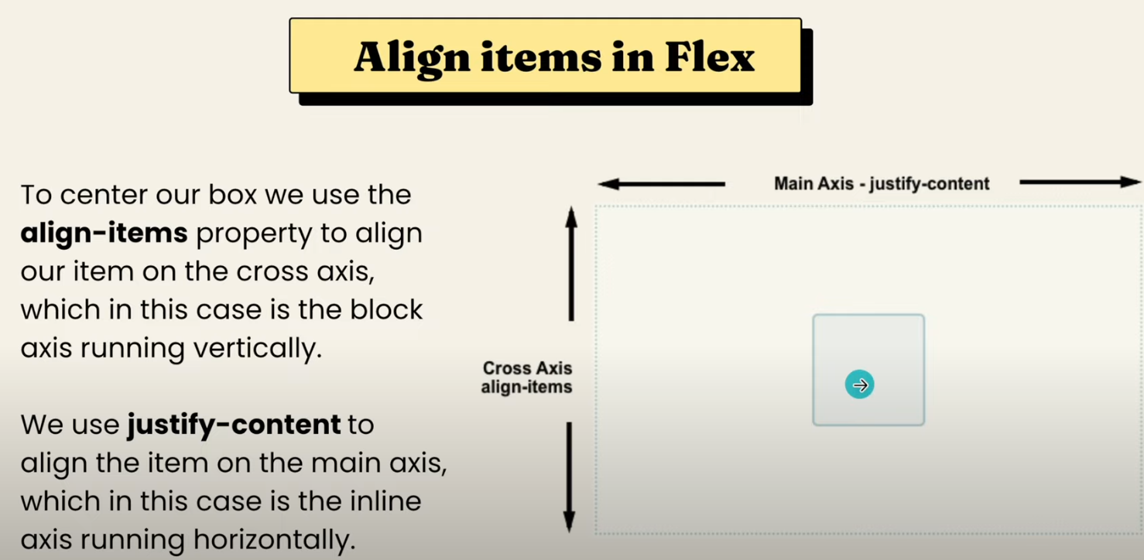
CSS FlexBox

Slide 28
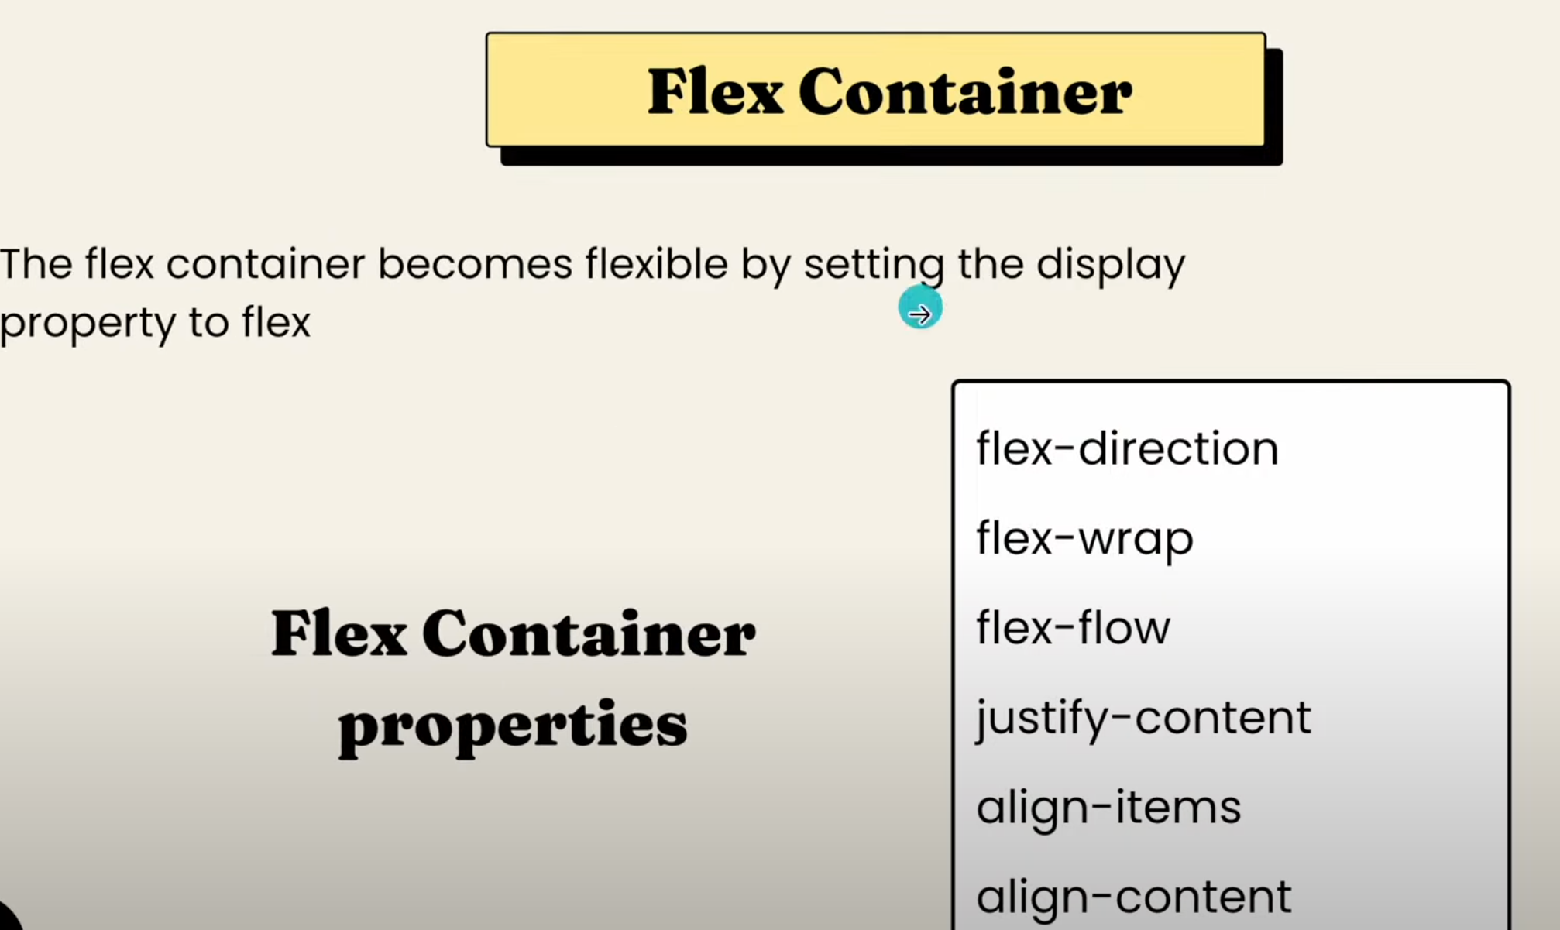
CSS FlexBox

Slide 29
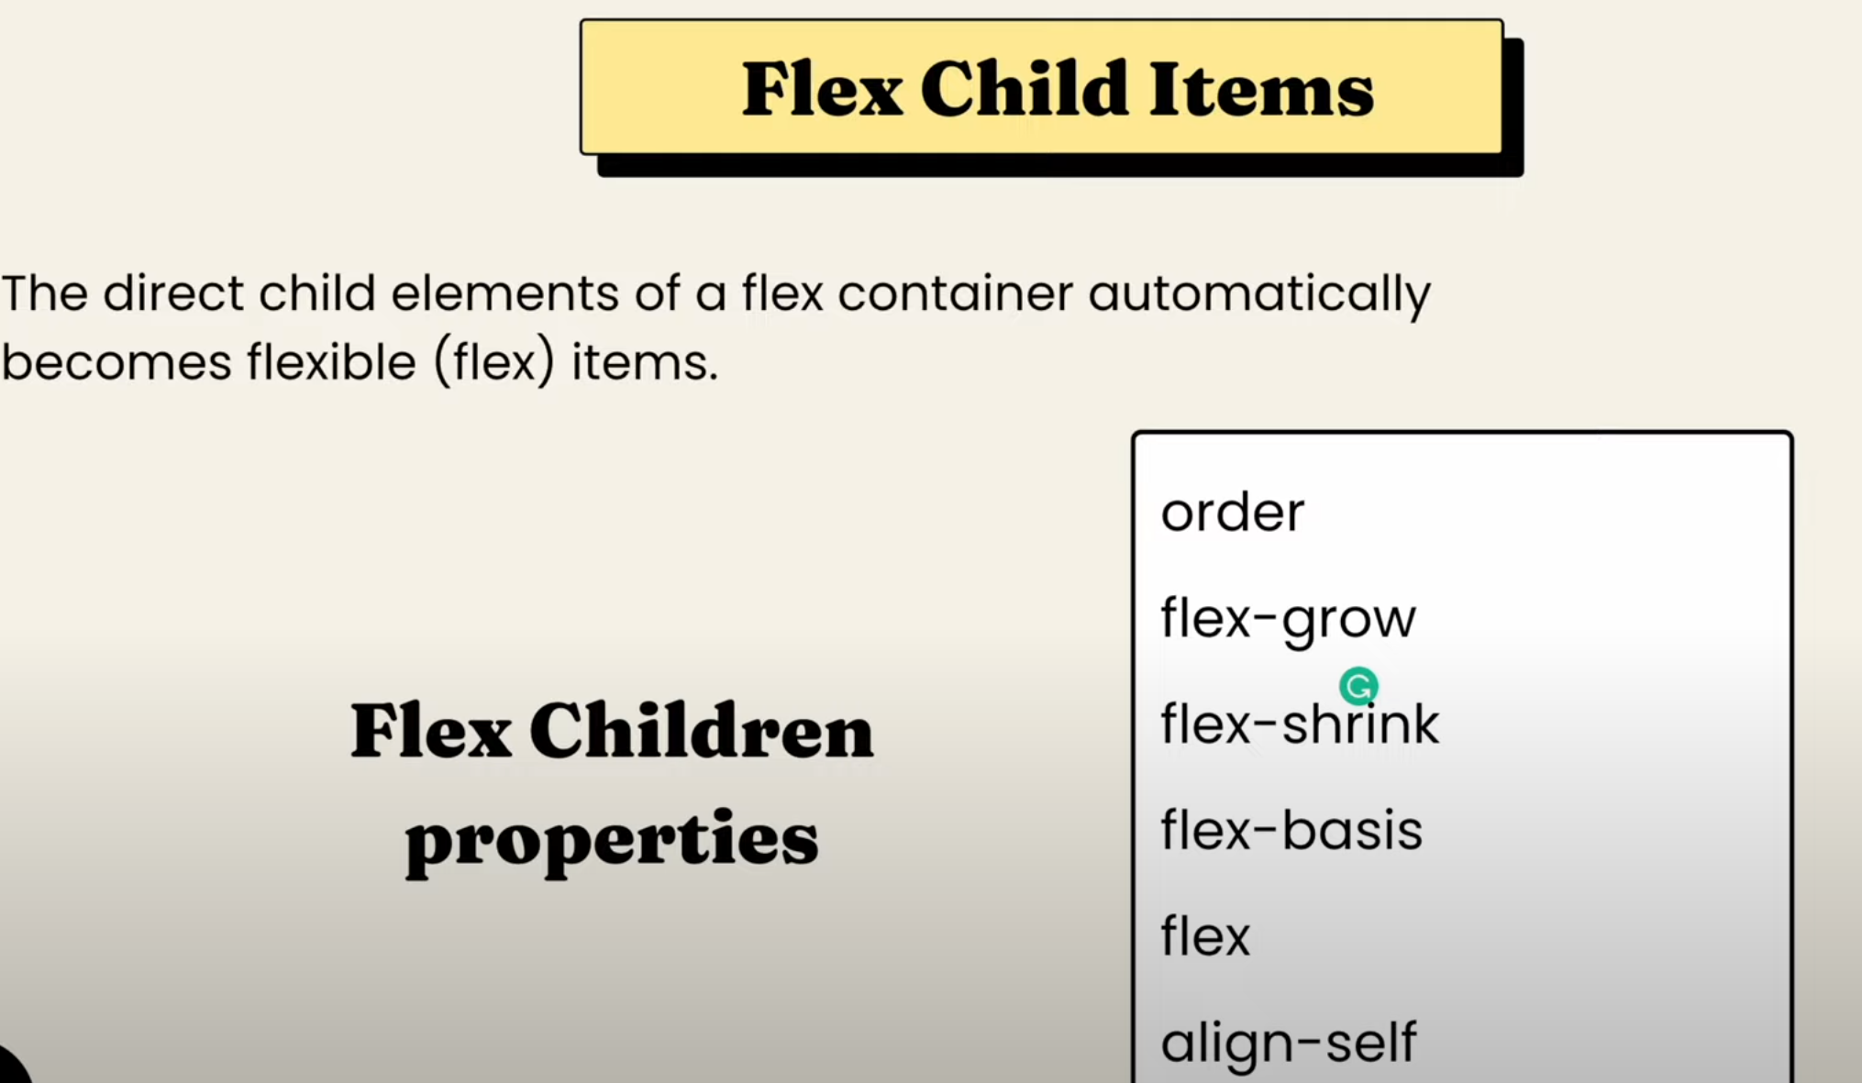
CSS FlexBox

Slide 30
The flex container properties are: 1. Flex Direction It defines in which direction the flex elements would be displayed. It takes values like row, column or “reverse” too. 2. Flex Wrap By using this property we can make our elements responsive for different screen sizes. 3. Justify Content This property is used to set the position of content or rather align content along the main axis. 4. Align Items Just like the justify-content property, align-items define the alignment of the flex container but along the cross-axis.
Flex Container Properties

Slide 31
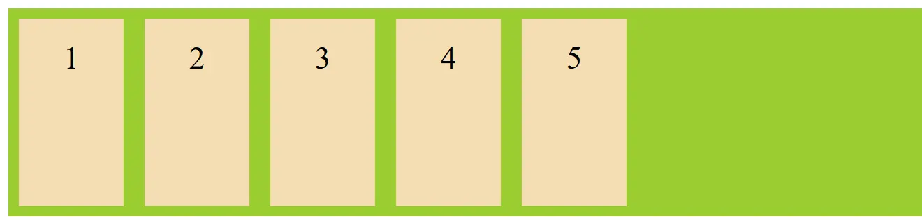
5. Align Content This property is very similar to align item but here rather than the flex items, the content present in the item is selected for the property. .flex-container { display: flex; height: 200px; flex-direction: row; background-color: yellowgreen; align-content: center; }

Slide 32
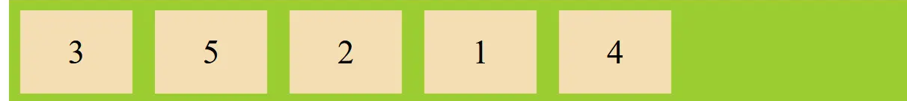
The flex item properties are: 1. Order: As the name suggests, this property sets the order in which the flex items are shown. <div style="order: 4;">1</div> <div style="order: 3;">2</div> <div style="order: 1;">3</div> <div style="order: 5;">4</div> <div style="order: 2;">5</div>
Flex Items Properties

Slide 33
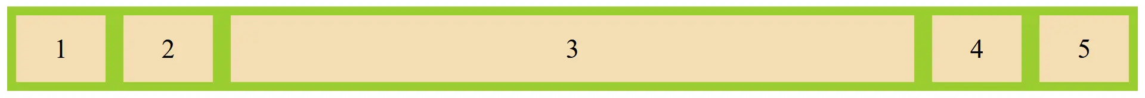
By default, this property is zero and thus items have the same size. Eg: <div>1</div> <div>2</div> <div style="flex-grow: 3;">3</div> <div>4</div> <div>5</div>
2. Flex Grow & Shrink

Slide 34
3. Align Self This property allows default alignment to be overridden for the individual flex items.

Slide 35
1. The CSS Grid Layout Module offers a grid-based layout system, with rows and columns, making it easier to design web pages without having to use floats and positioning. 2. An HTML element becomes a grid container when its display property is set to grid or inline-grid. .grid-container { display: grid; }
Grid Layout

Slide 36
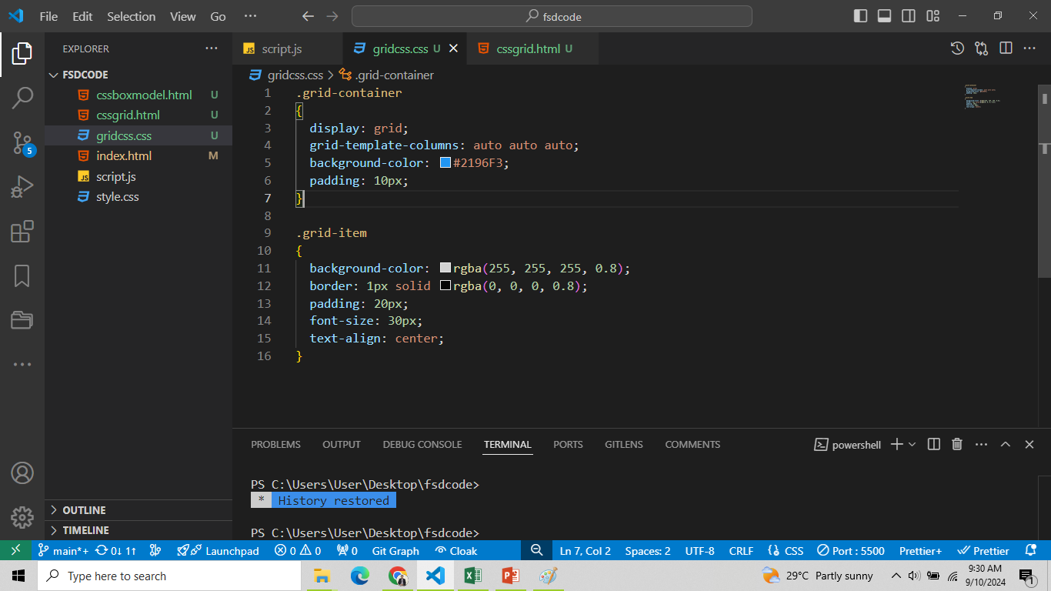
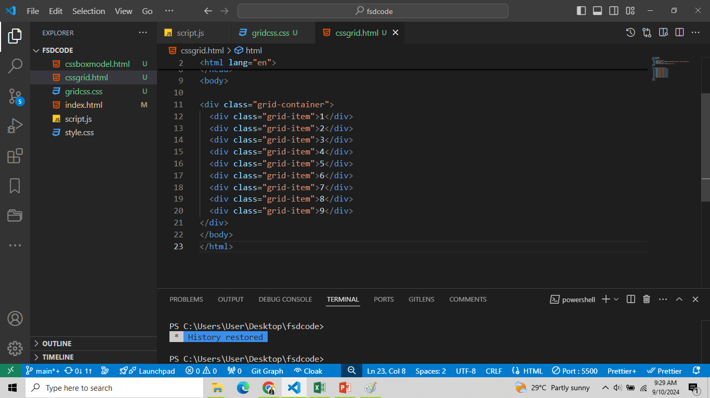
.grid-container { display: grid; grid-template-columns: auto auto auto; background-color: #2196F3; padding: 10px; } .grid-item { background-color: rgba(255, 255, 255, 0.8); border: 1px solid rgba(0, 0, 0, 0.8); padding: 20px; font-size: 30px; text-align: center; }
CSS Grid Example

Slide 37
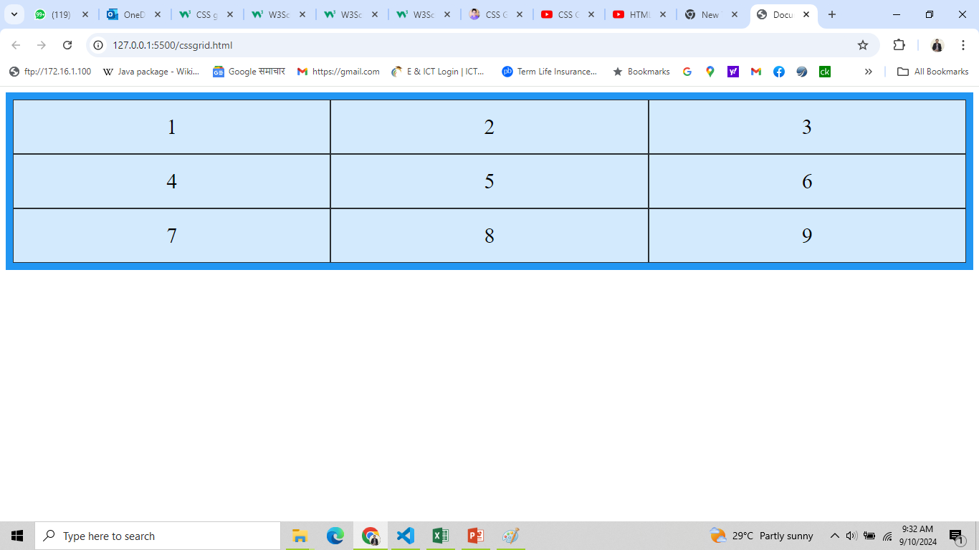
Output

Slide 38
The CSS positions allow you to precisely control the placement of an element on the web page. It helps to determine how elements are placed inside the container element and how they interact with the other elements on the page. There are various types of position property values, such as: Static(Default) The elements are positioned according to the normal flow of the document. Syntax: selector { position: static; }
CSS Positioning

Slide 39
Elements are positioned relative to the normal position in the document. You can use the top, right, bottom, and left properties to move the element from its original position. Syntax: selector { position: relative; } <style> img { position: relative; left: 100px; top: 50px } </style>
Relative

Slide 40
Elements are positioned relative to the closest positioned ancestor (parent), which means we need to have a parent element with a positioning other than 'static’. Note: An absolutely positioned element is removed from the normal flow. Example: <style> #about{ position: relative; } .logo{ position: absolute; right: 10px; top: 10px; } </style>
Absolute

Slide 41
Elements are positioned relative to the viewport (screen) and do not move when the page is scrolled. This is useful for creating elements like fixed headers or footers. Example: <style> h1{ position: fixed; top: 10px; right: 20px; } </style>
Fixed

Slide 42
Position sticky is a hybrid between 'relative' and 'fixed'. It allows an element to become "stuck" to the top or bottom of its container when scrolling, but it behaves like relative positioning within the container until it reaches a specified offset. Example: <style> h1{ position: sticky; top: 10px; right: 20px; } </style>
Sticky

Slide 43
Media queries are used when we want to customize our website's presentation according to the user's screen size. With the help of media queries, user can display different markups based upon the device's general type(mobile, desktop, tablet). It is a logical operation. Whenever a media query becomes true, then the related CSS is applied to the target element. Syntax: @media media-type and (media-feature)
CSS Media Queries

Slide 44
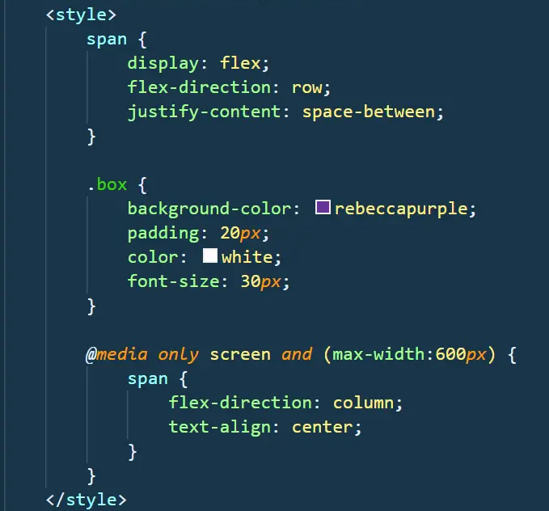
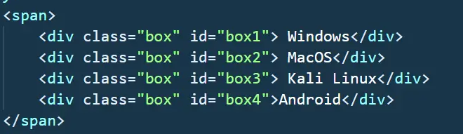
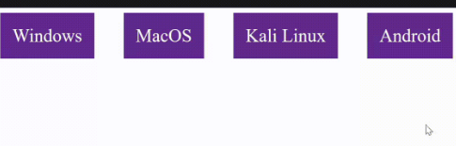
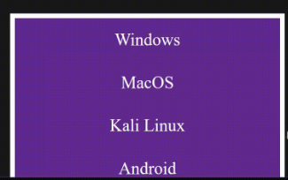

Slide 45
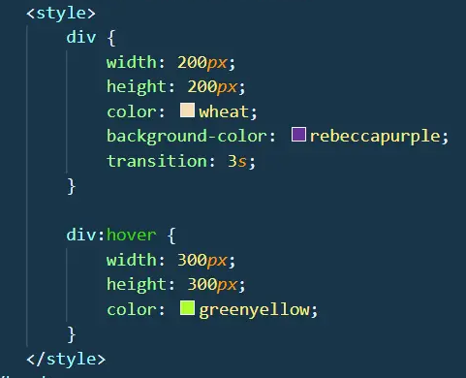
Transitions control the ease of transformation from one style to another when we hover over that element. Basically, you can control the time take for any transformation to occur.
CSS Transitions

Slide 46

Reference
W3School (w3school.com)
Code With Harry (codewithharry.com)
Amazon Web Service (https://aws.amazon.com/)

Slide 47
Thank You

